Slide 1




1
Power BI
QUICK START
Prepared By :
Said Fawzy
Manager of Information Center
Tendering Department
Arab Contractors

Slide 2
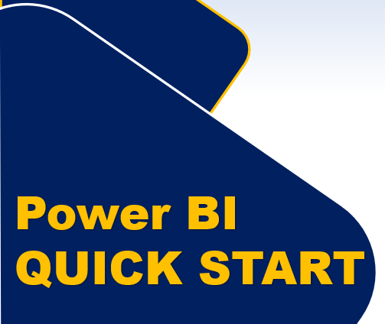
Module 1
Introduction to Power BI

Slide 3
01
What is Power BI
02
Power BI History
Module Contents
What can you Expect from this course
03
What do you need for this course
04

Slide 4
05
Power BI Architecture
06
Walkthrough Journey of Power BI
Module Contents
Power BI Licenses
07
Download Power BI
08

Slide 5
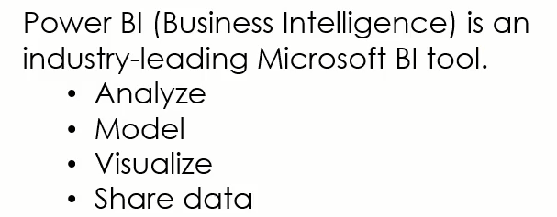
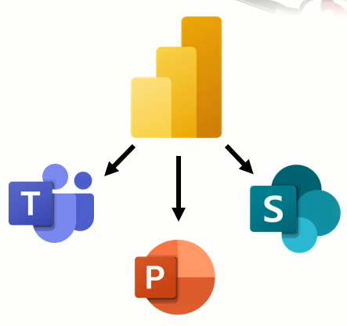

What is Power BI
Integration

Slide 6
What is Power BI
Purpose of Power BI
The ultimate purpose of Power BI is to put the power of data-driven decision-making into the hands of businesspeople in companies of any size anywhere.

Slide 7
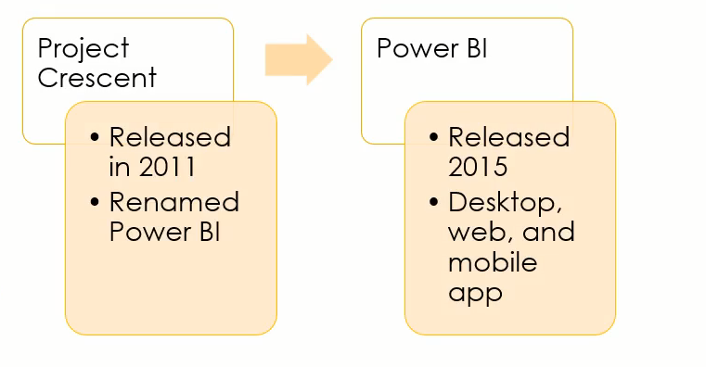
Power BI History

Slide 8

What you can expect from this course

Slide 9

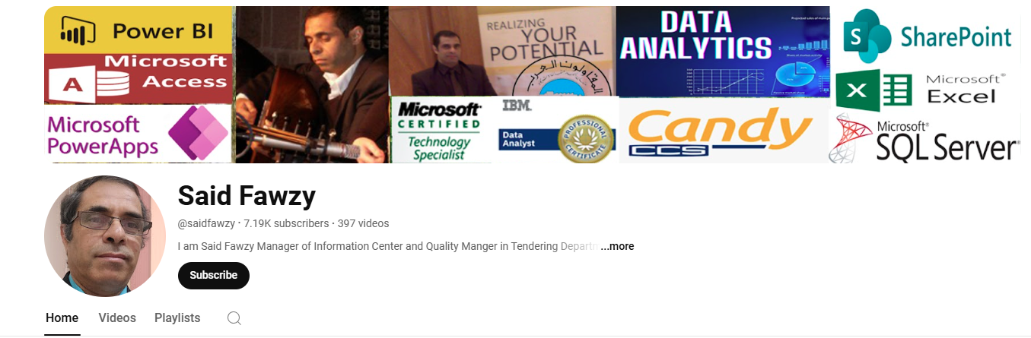
What you can expect from this course
You will receive your instructions in the form of practical example step by step.
You can also follow the course on my Channel on YouTube:
www.youtube.com/saidfawzy

Slide 10
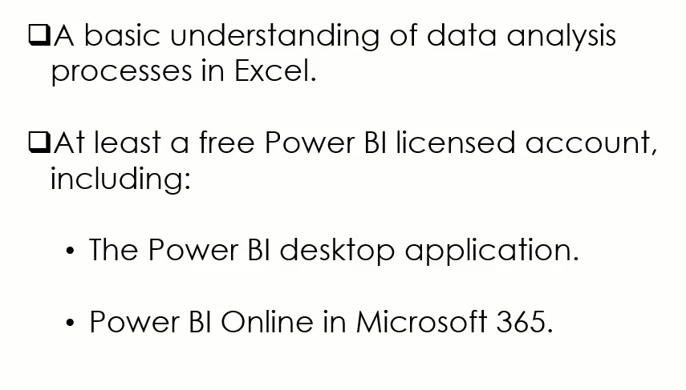
What do you need for this course

Slide 11

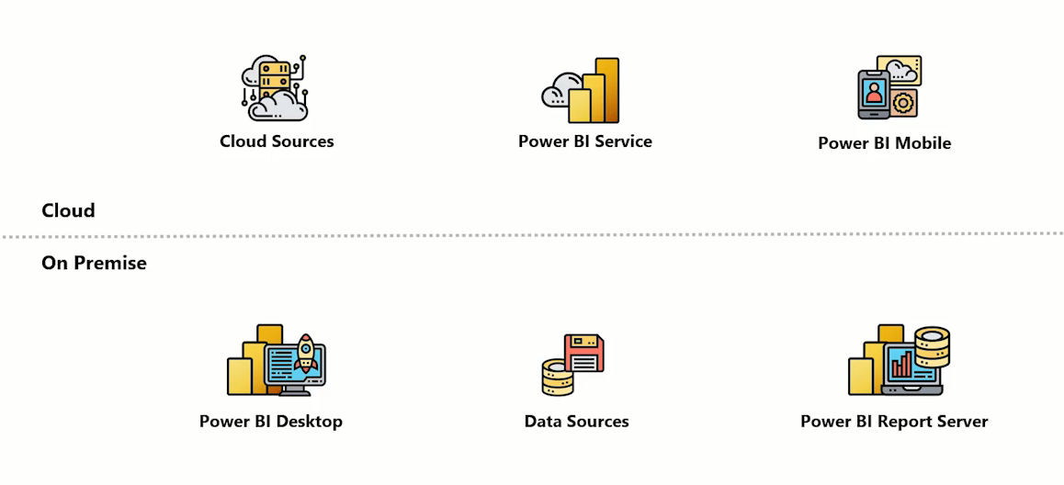
Power BI Architecture
Publish
Gateway

Slide 12
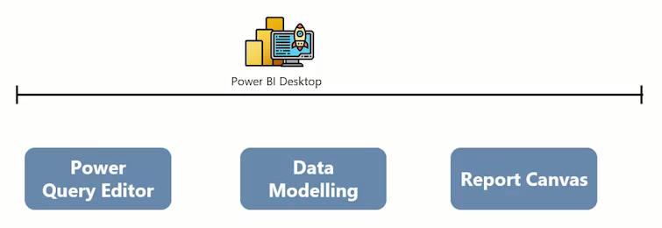
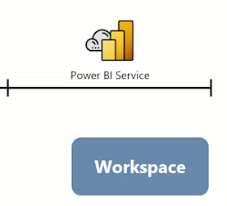
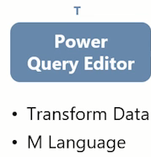
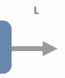
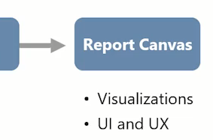
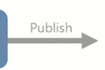
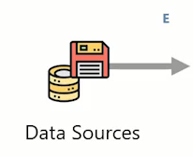

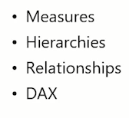
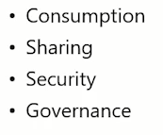
Power BI End to End Process Flow

Slide 13
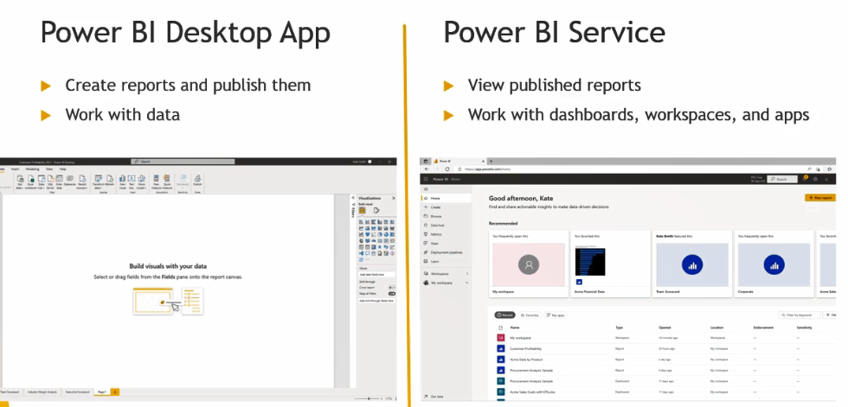
Walk Through Journey of Power BI

Slide 14
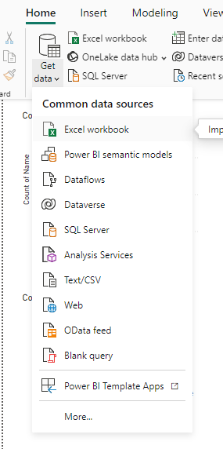
Walk Through Journey of Power BI
Getting Data

Slide 15
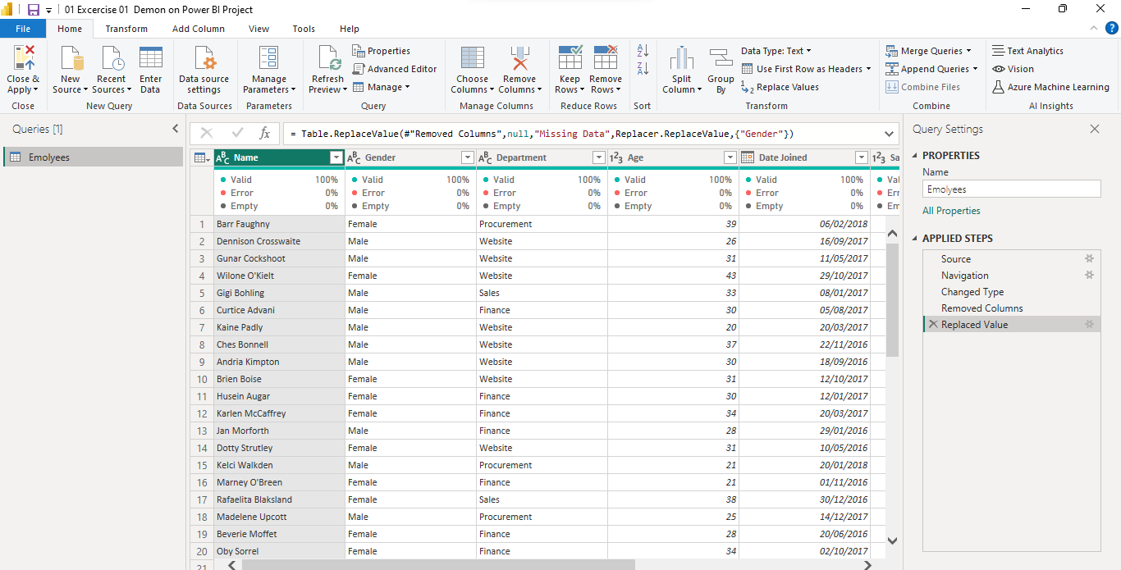
Walk Through Journey of Power BI
Power Query

Slide 16
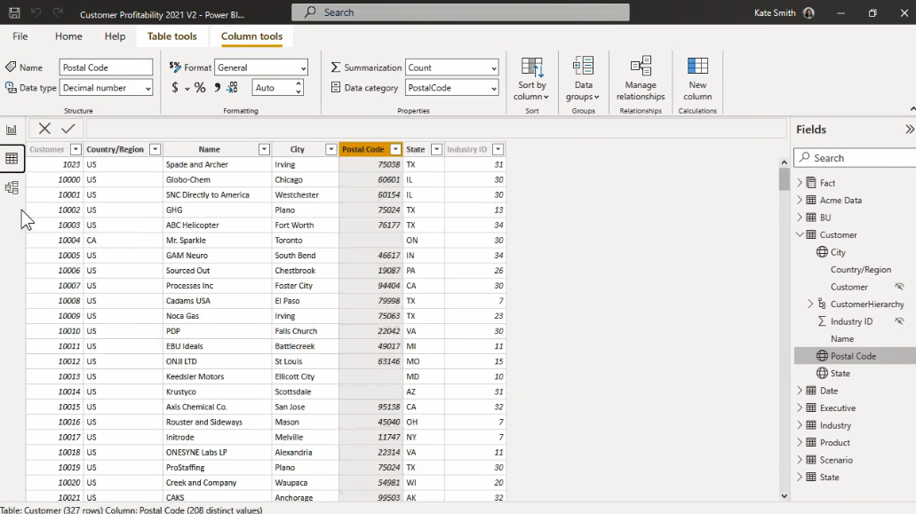
Walk Through Journey of Power BI
Table View

Slide 17
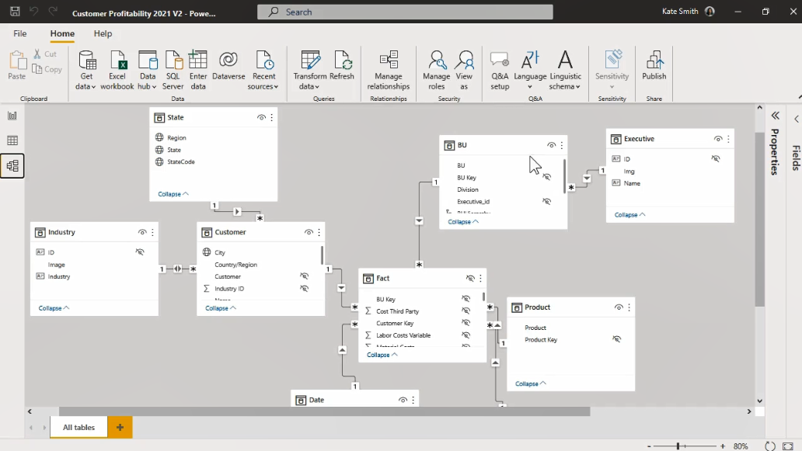
Walk Through Journey of Power BI
Model View

Slide 18
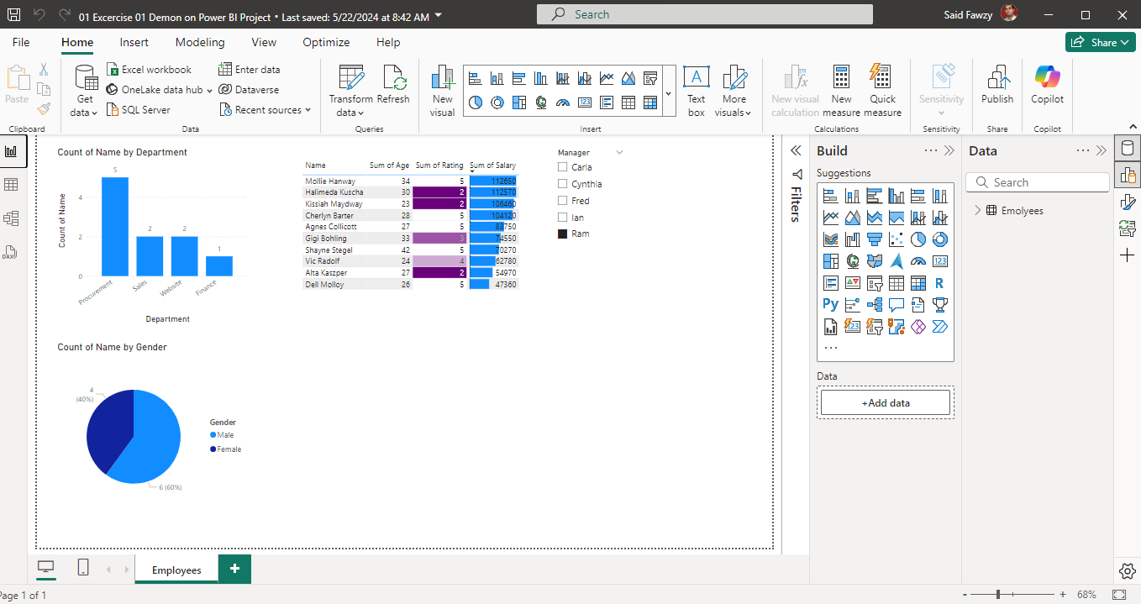
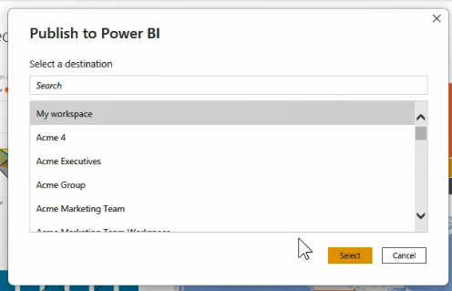
Walk Through Journey of Power BI
Report View

Slide 19
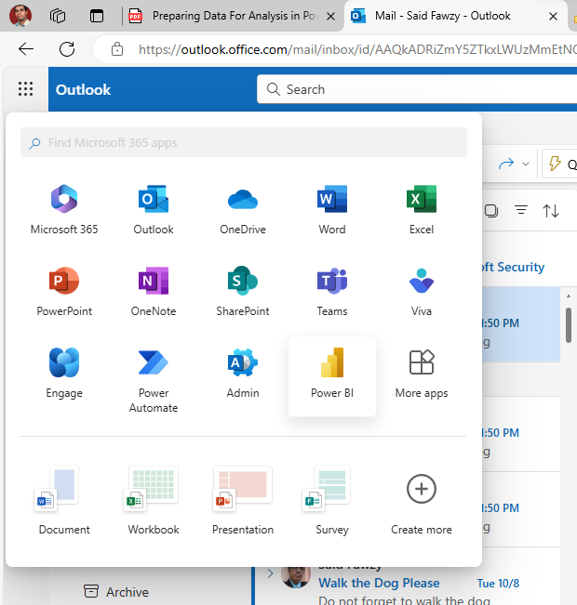
Walk Through Journey of Power BI
Power BI Service

Slide 20
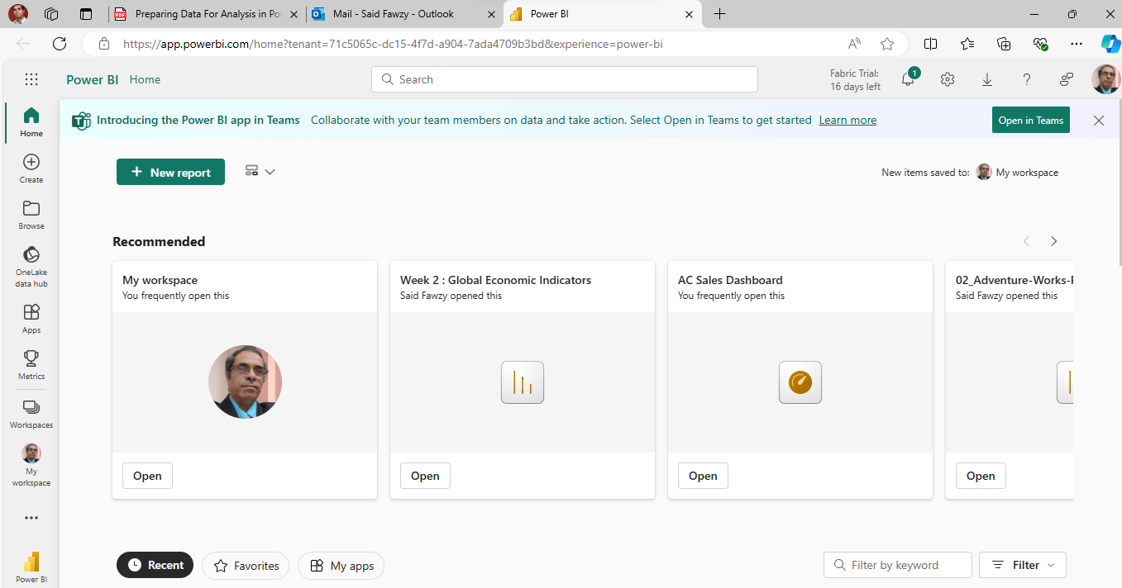
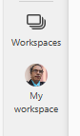
Walk Through Journey of Power BI

Slide 21
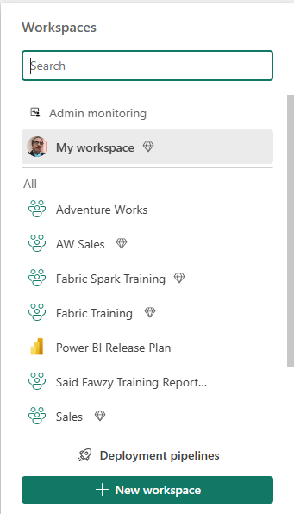
Walk Through Journey of Power BI
My Workspace is private

Slide 22
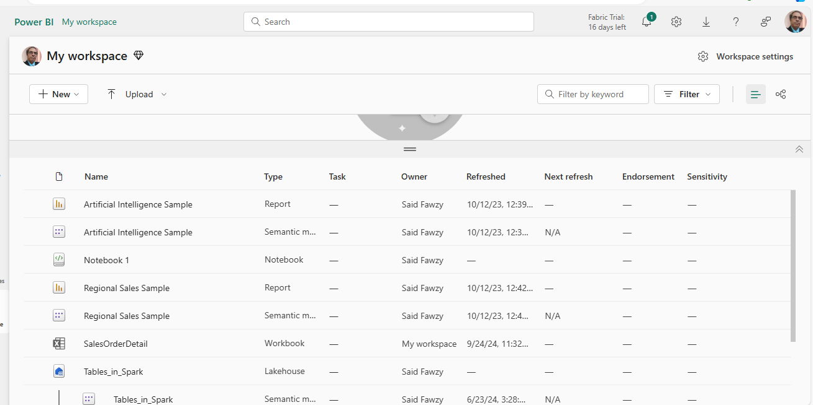
Walk Through Journey of Power BI

Slide 23
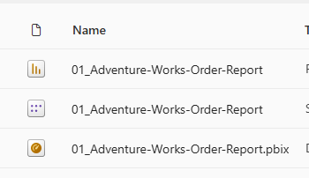
Walk Through Journey of Power BI
Report
Symantec Model
Dashboard

Slide 24
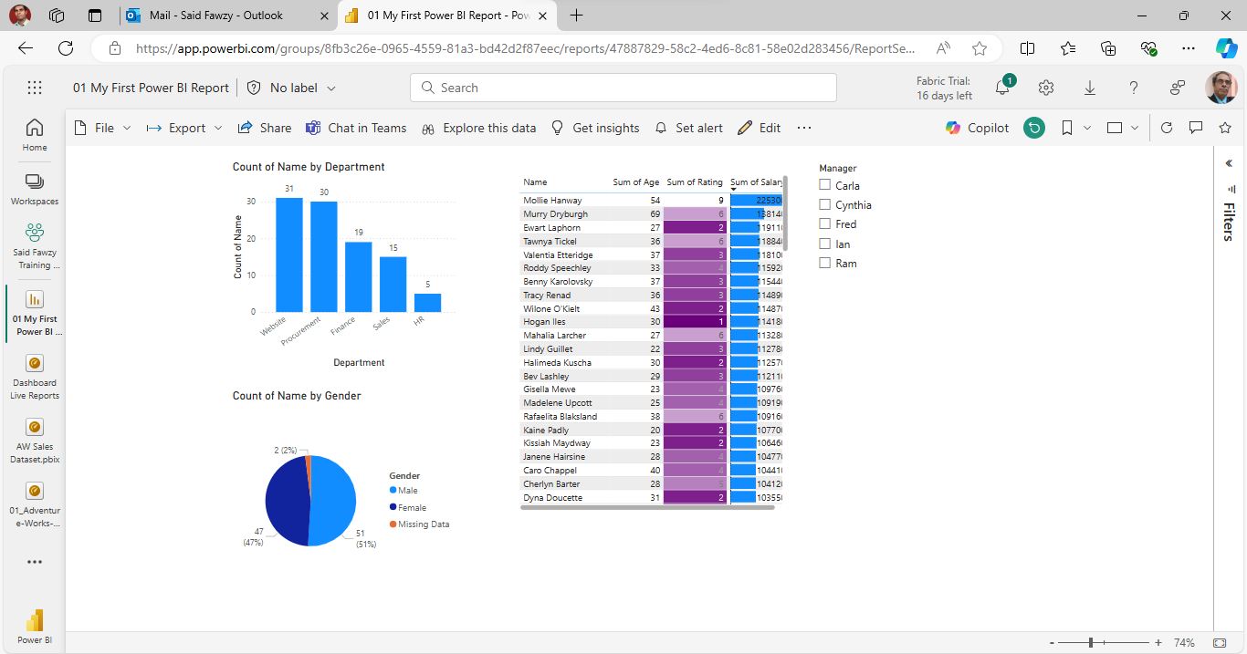
Walk Through Journey of Power BI
Published Report

Slide 25
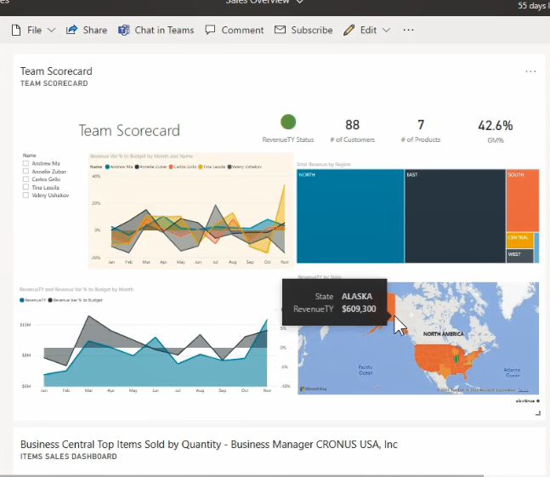
Walk Through Journey of Power BI
Dashboard

Slide 26
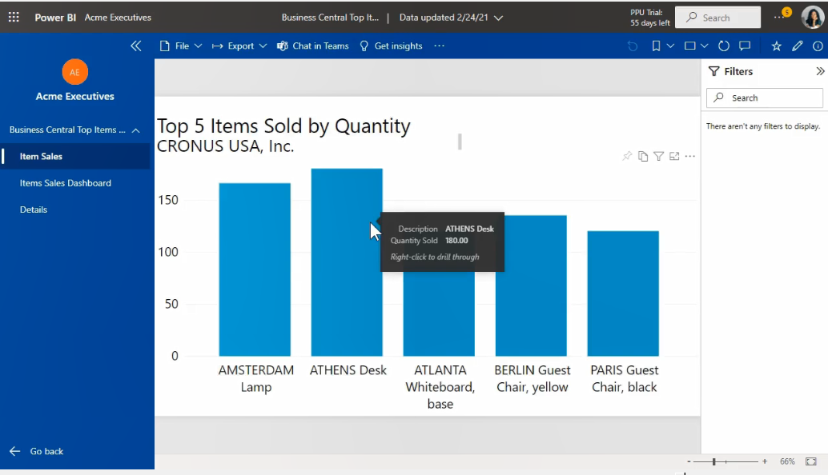
Walk Through Journey of Power BI
Apps

Slide 27

Exercise 1
Walkthrough Power BI Journey

Slide 28
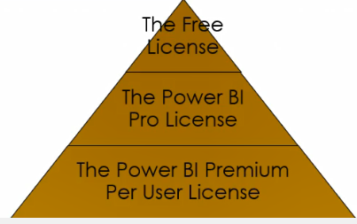
Power BI Licenses

Slide 29

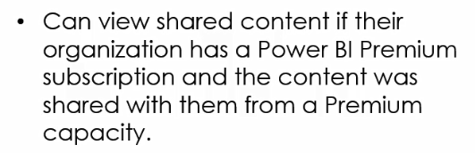

Power BI Licenses
Free License

Slide 30

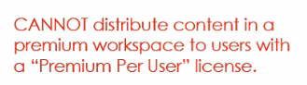

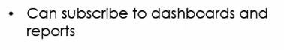
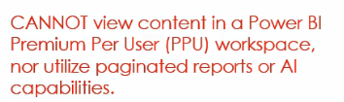
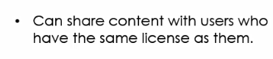
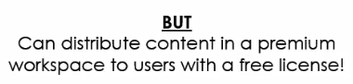
Power BI Licenses
Pro License

Slide 31
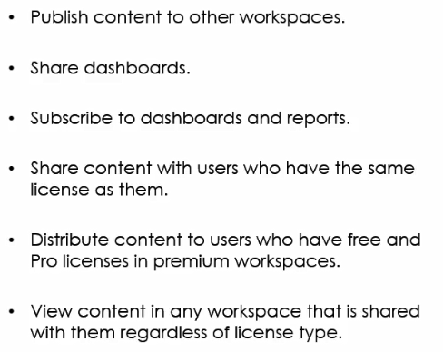
Power BI Licenses
Premium Per User (PPU) License

Slide 32
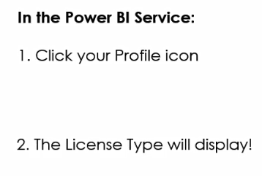
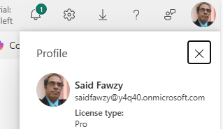
Check Your Power BI Licenses

Slide 33
Download Power BI Desktop
Option 1: Power BI Site
https://powerbi.microsoft.com/en-us/downloads/
Advantage: You can apply to many computers

Slide 34
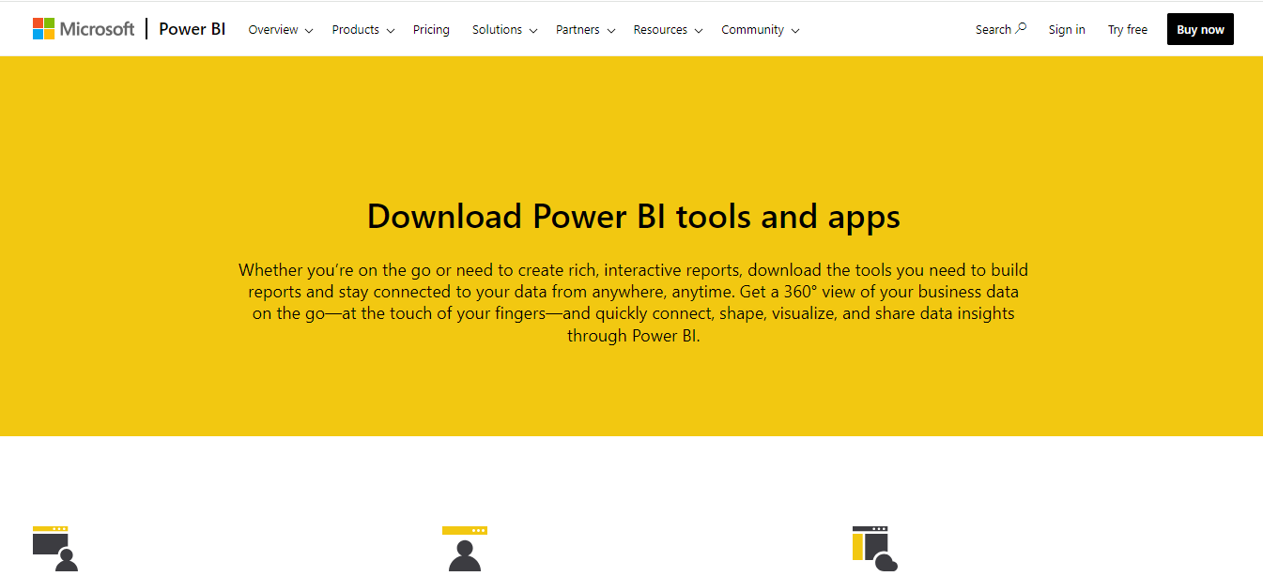
Download Power BI Desktop
https://powerbi.microsoft.com/en-us/downloads/

Slide 35
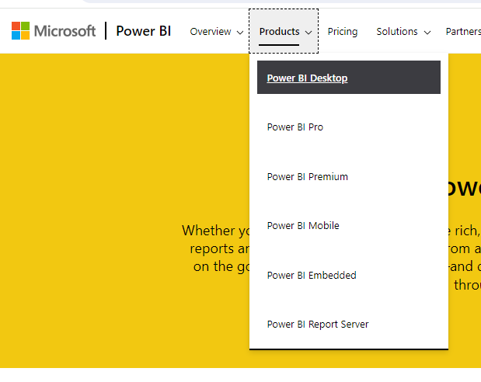
Download Power BI Desktop

Slide 36
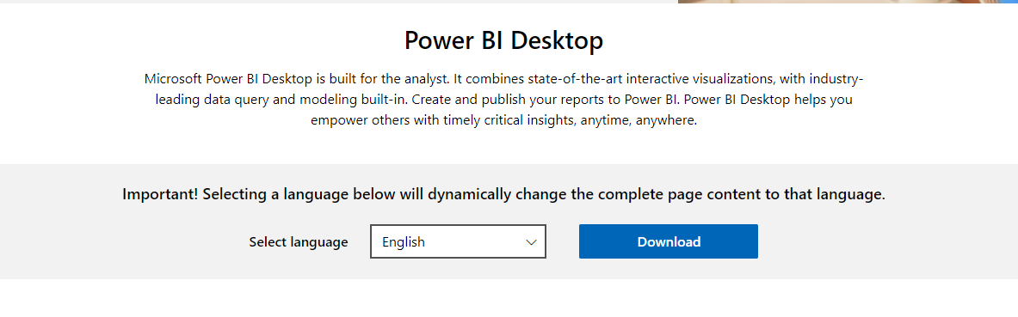
Download Power BI Desktop

Slide 37

Download Power BI Desktop
Option 2: Microsoft Store
Advantage: Software Updates Automatically

Slide 38
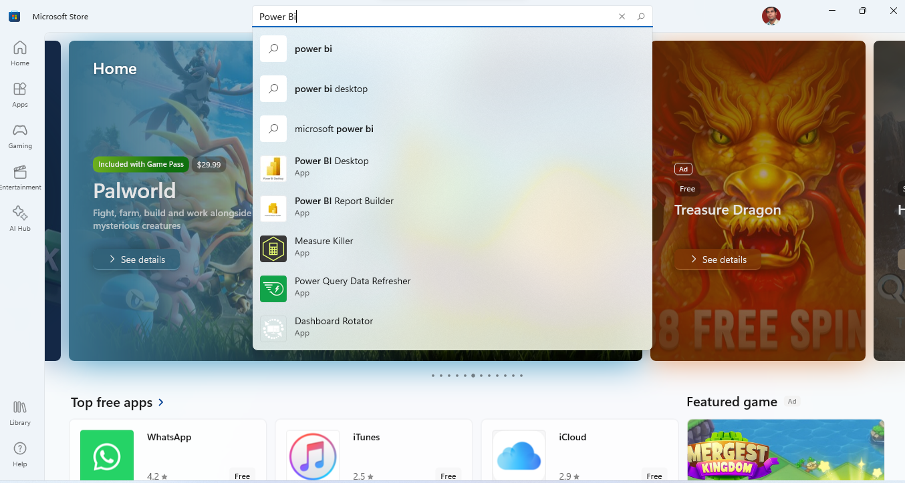
Download Power BI Desktop

Slide 39
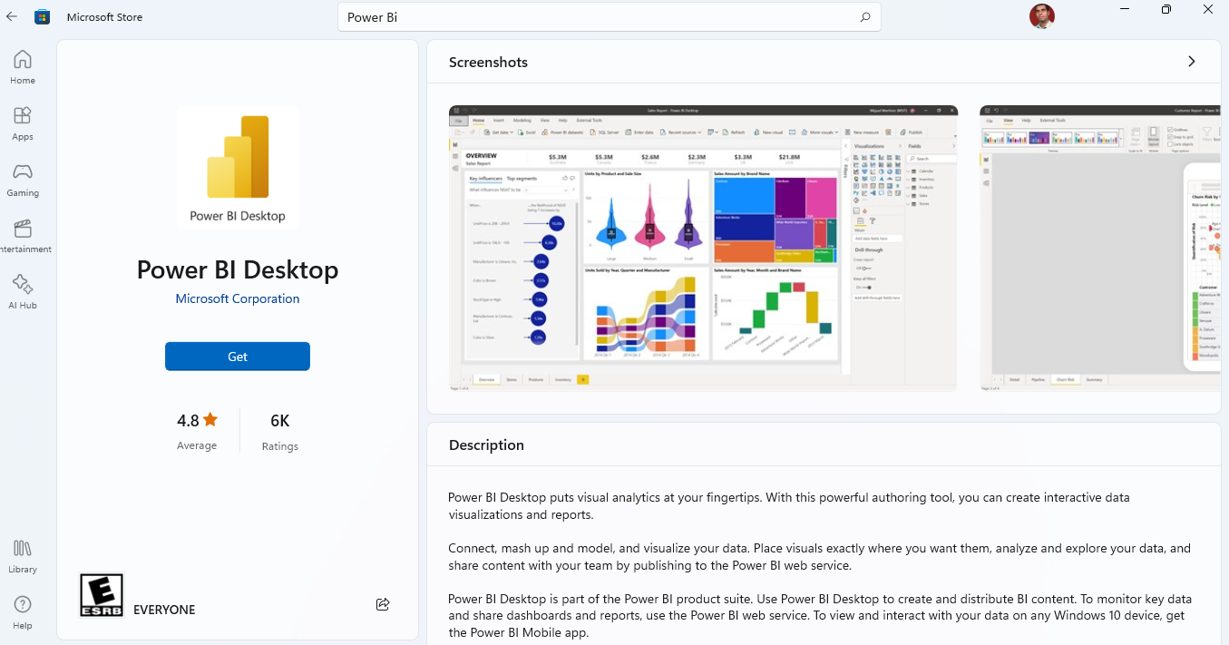
Download Power BI Desktop

Slide 40


